Slide 1
DC Motor Control
Introduction

Slide 2
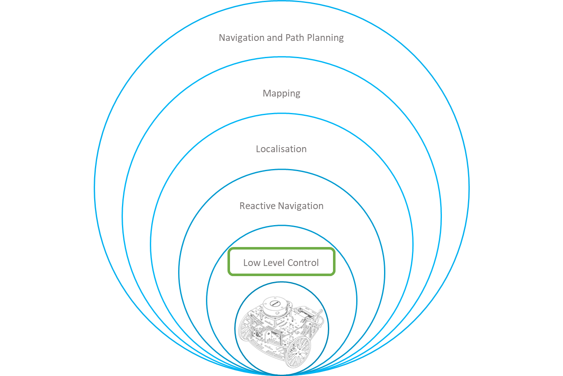
Control Hierarchy
Robotics systems, are intended to perform complicated tasks in different environments. Such tasks, can be performed autonomously, semi-autonomously or remote controlled.
The control of such systems can become very complex depending on the task to perform.
The HCS divides the control into layers, dividing each complex task into subtasks (goals) to be achieved by a dedicated layer.
This course is dedicated to the Low-Level control layer using ROS.

Slide 3
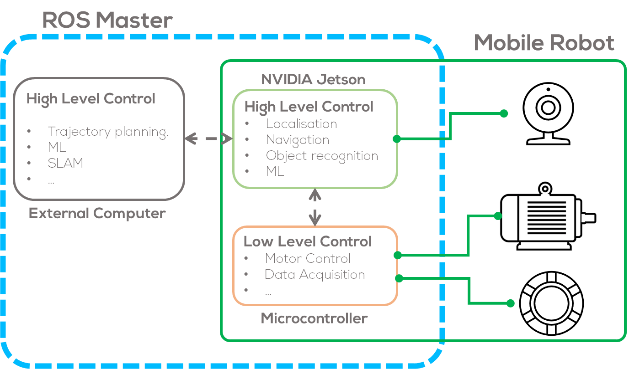
ROS Control Hierarchy

Slide 4
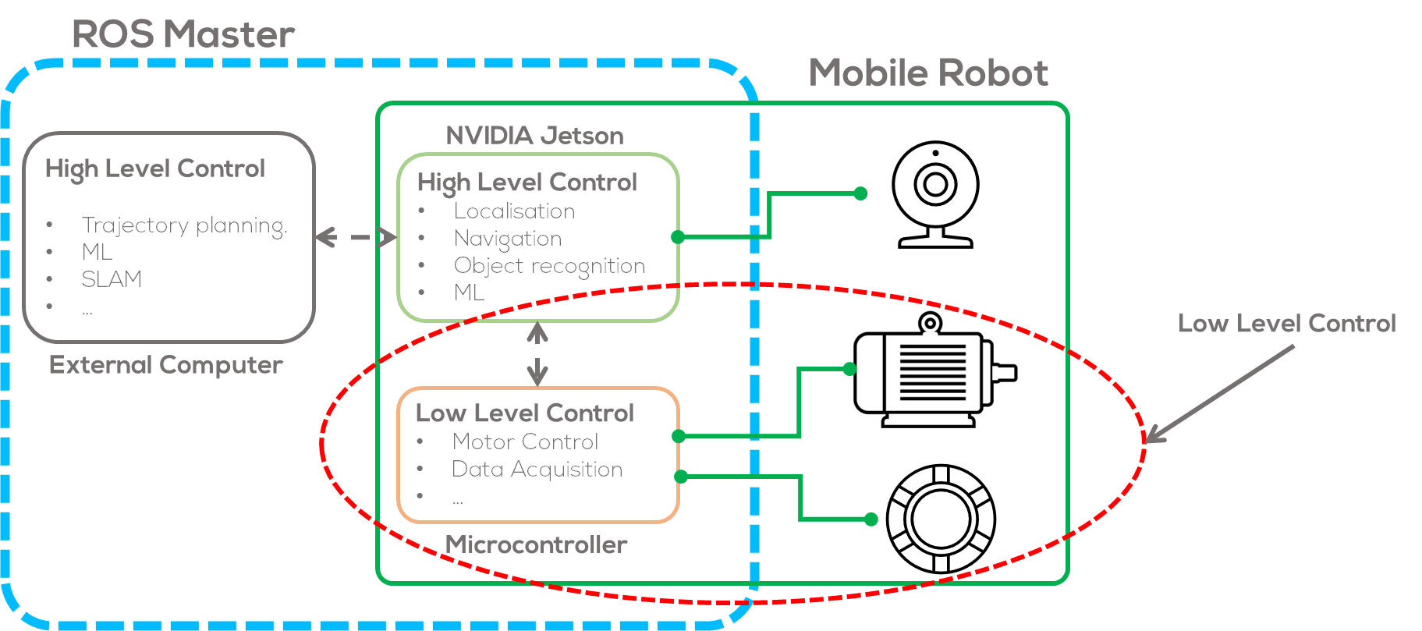
ROS Control Hierarchy

Slide 5
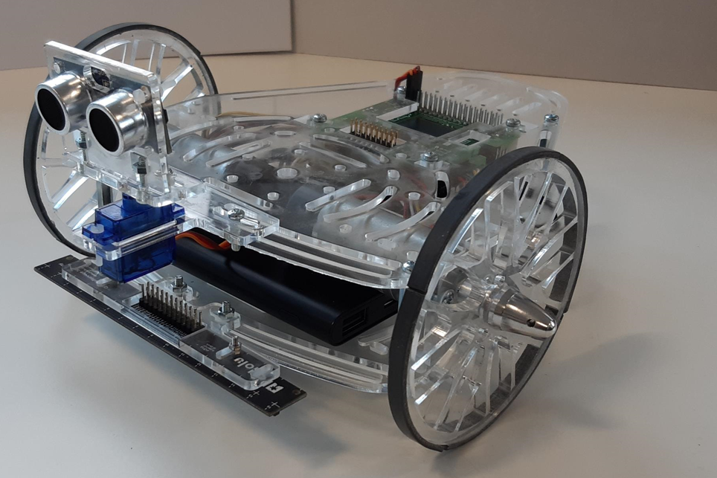
Mobile robots
Mobile robots, require different sensors and actuators to read information from the environment, and to interact with it.
One of the most common actuators found in most robotic systems are DC motors.
DC Motors are found in different robotics applications from wheeled mobile robots, to robotic manipulators and unmanned aerial vehicles.
One example of a wheeled mobile robot is the Puzzlebot, which uses two DC motors one for each wheel.
DC motors, are a widely studied in different fields of science from electromechanical systems to control engineering.
Puzzlebot by Manchester Robotics.

Slide 6
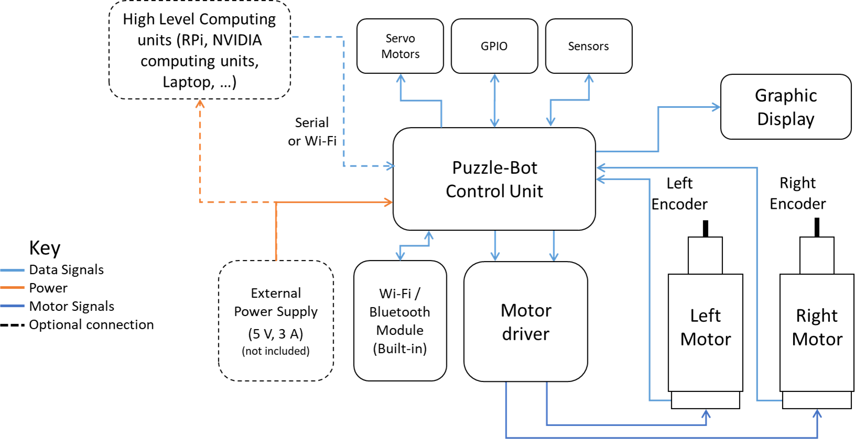
Puzzlebot sensors and actuators

Slide 7
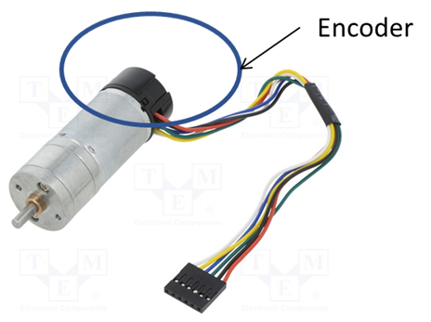



DC Motors
Introduction
A direct current (DC) motor is a type of electric machine that converts electrical energy into mechanical energy.
DC motors take electrical power through direct current and convert this energy into mechanical rotation.
This is done by using generated magnetic fields from the electrical currents, powering the movement of a rotor fixed within the output shaft.
The output torque and speed depends upon both the electrical input and the design of the motor.
DC Brushed Motor with Encoder.
DC Motor
$$ω$$
$$V$$
$$τ$$
DC Motor Model Representation.

Slide 8
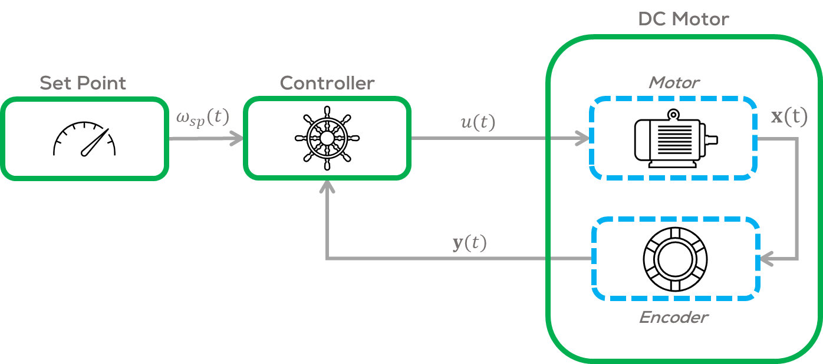
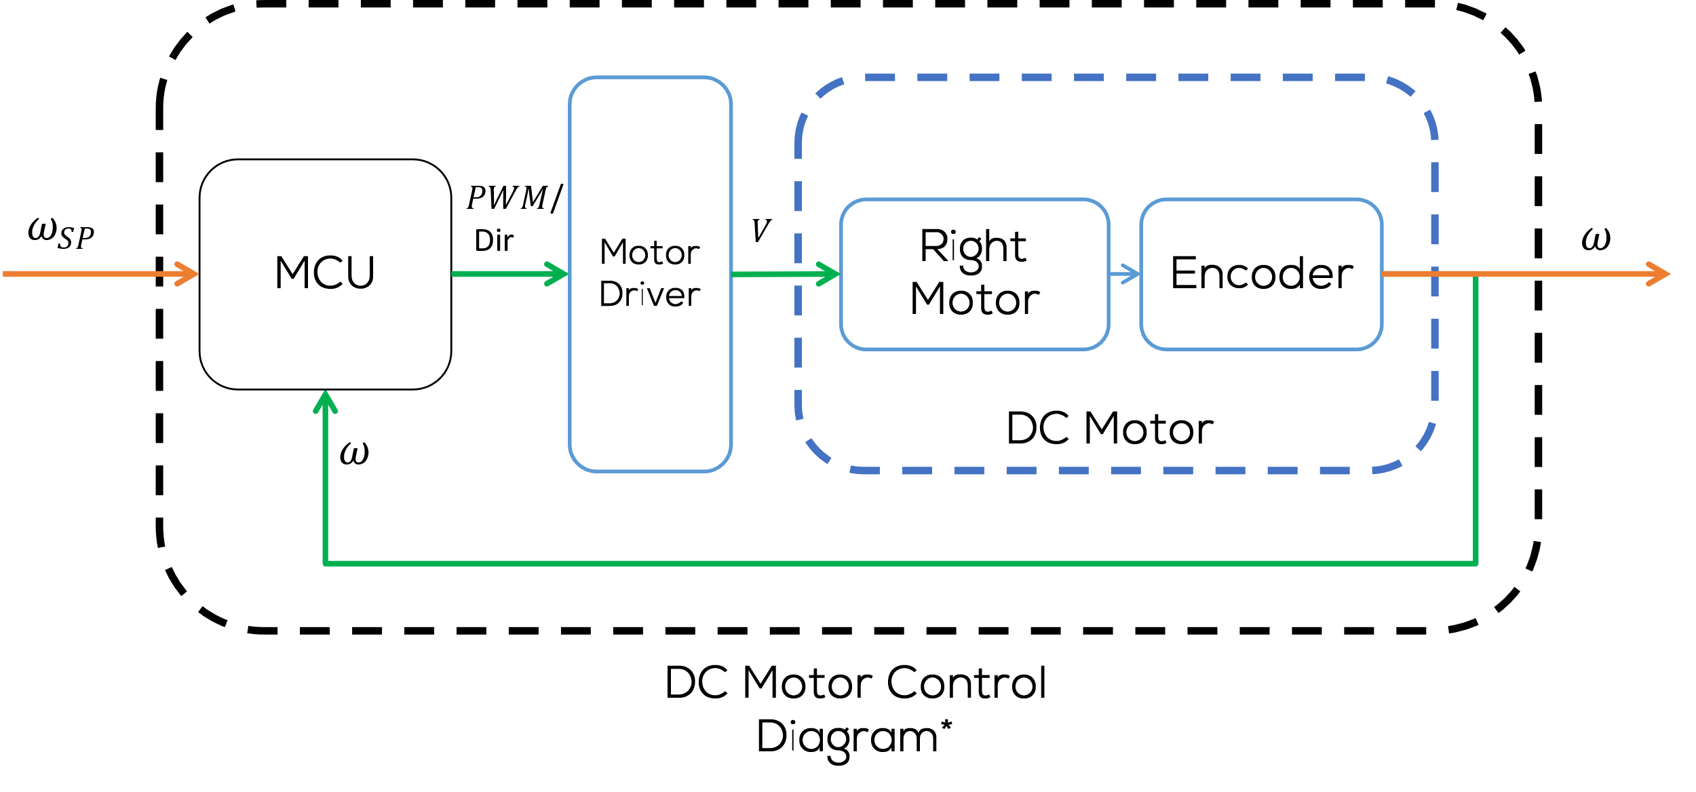
DC Motors
In robotics, controllers are used to regulate the rotational speed, angular position or torque, required by the application.
In robotics this is called low level control.
For the case of a wheeled mobile robot is a common practice to implement a PID control to regulate the angular speed of the DC motors.
The regulation of the angular speed or position of a motor, requires different stages.
Controller Stage
Power Stage (Driver)
Plant
Sensor Stage

Slide 9
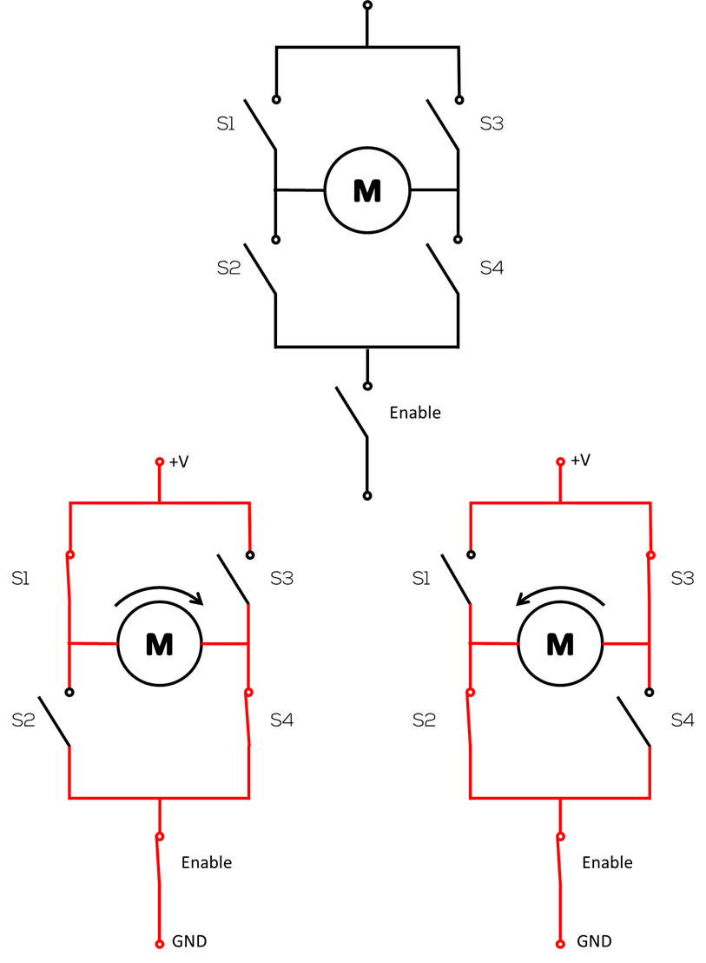
Motor Driver
H-bridge is an electronic circuit that switches the polarity of a voltage applied to a load.
They work using a combination of switching components (mechanical switches, transistors, etc.), as shown in the diagram, to change the polarity to the load.
H-Bridge Drivers are some of the most common motor drivers used in the control DC motors to run forwards or backwards.
H-Bridge motor Driver Diagram
S1 | S2 | S3 | S4 | Motor
0 | 0 | 0 | 0 | Motor Off
1 | 0 | 0 | 1 | Right Turn
0 | 1 | 1 | 0 | Left Turn
1 | 1 | 0 | 0 | Short Circuit
0 | 0 | 1 | 1 | Short Circuit

Slide 10
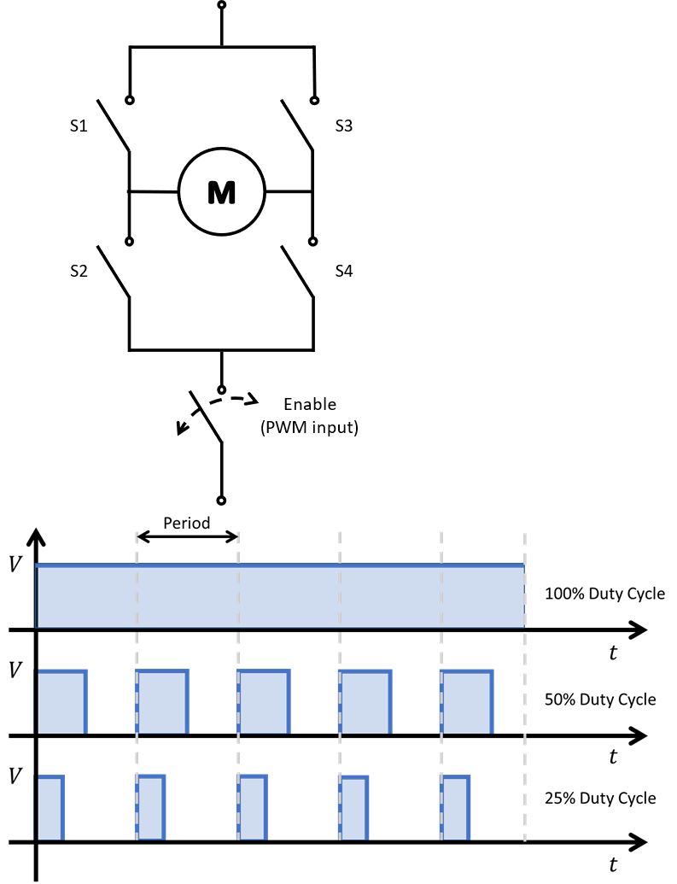
Motor Driver
Another capability of the motor driver is to regulate the angular speed of the motor.
There are many ways to obtain this result, one of the most common one is to send a PWM (Pulse width modulated signal) to the enable pin of the H-Bridge.
PWM (Pulse Width Modulation): Is a technique used in engineering to control the average power delivered by an electrical signal, by dividing it into discrete parts.
In practice this is accomplished by rapidly turning the switch between the load and the source (enable switch), ON and OFF.
PWM Input
PWM Duty Cycle

Slide 11
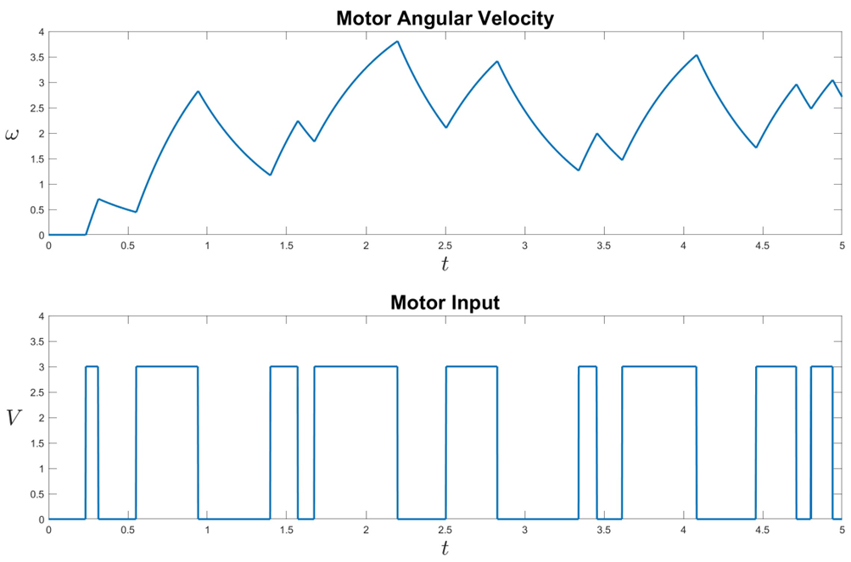
Motor Driver
Given that the motor can be modelled as a second order systems, when applying a PWM voltage as an input, it is possible to observe the output behaviour as in the figure.
This behaviour, can be used to control the power give to the motor and therefore controlling the motor angular speed.
Motor Output/Input

Slide 12
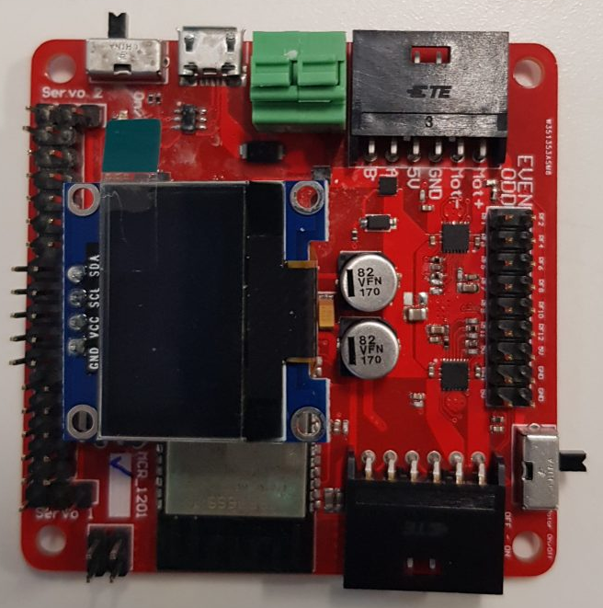
MCU
A microcontroller is a compact integrated circuit. They are made to perform a specific operation in an embedded system.
In robotics they are usually in charge of the low-level control of the robot, such as motors, and sensors or actuators that require a dedicated and fast controller to work.
A typical microcontroller includes a processor, memory and input/output (I/O) peripherals on a single chip.
For the case of the PuzzleBot:
ESP32-based Microcontroller
Xtensa dual-core 32-bit LX6 microprocessor
520 KB of SRAM
WiFi & Bluetooth
DC-DC Converter
Motor Driver
0.96” I2C LCD Display

Slide 13


Q&A
Questions?

Slide 14
Thank you

